Slide 1

RROS：A Rust Realtime Operating System

Slide 2












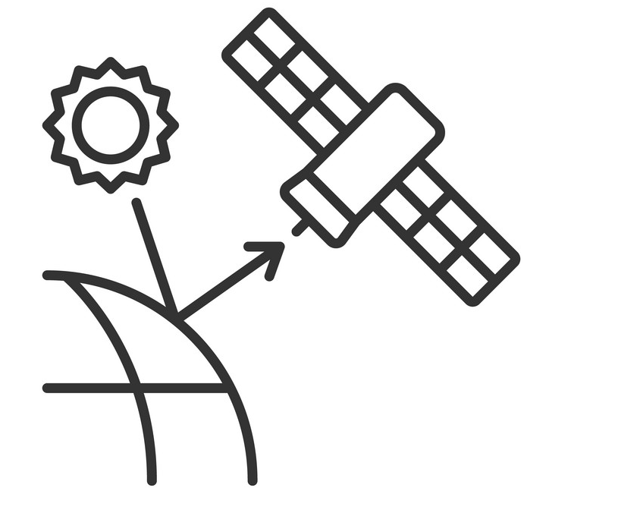




Background: Complication of end-device tasks
Complex terminal tasks
Mixed task requirements
Real-time tasks
Generic tasks

Slide 3






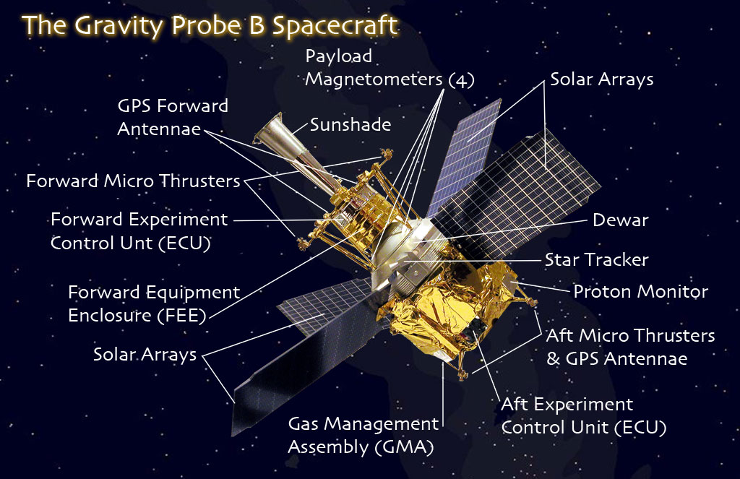
Scenario 1: Complication of satellite mission/payload tasks
Satellite Internet
Satellite constellations
Complication of satellite missions
Generalization of satellite missions
Satellite hardware heterogeneity, functions are configured, controlled and operated through software; There are underutilized computing and storage resources between multiple payloads of satellites; The Star Computer/Payload Control Unit has to handle both traditional real-time tasks and general-purpose tasks.
Satellites face various generalized tasks such as communication, navigation and positioning, earth observation, scientific experiments, emergency response, and resource exploration.
Solar sail panels
On-board
Computer
Load control unit
Solar sail panels

Slide 4

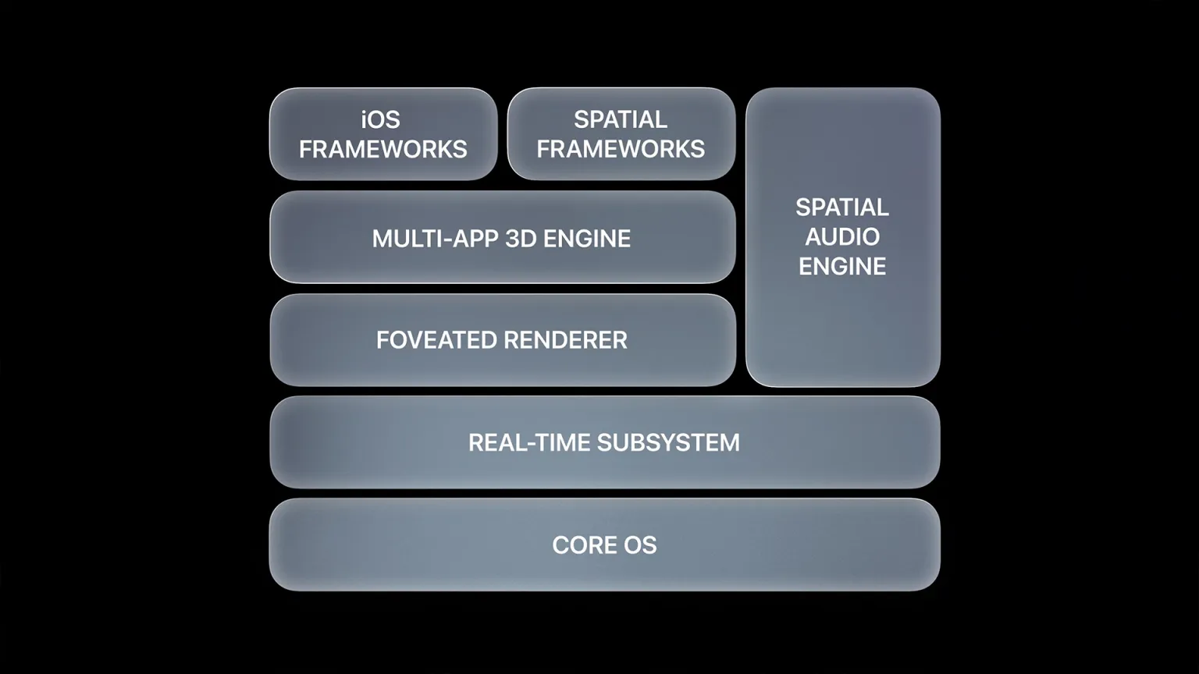
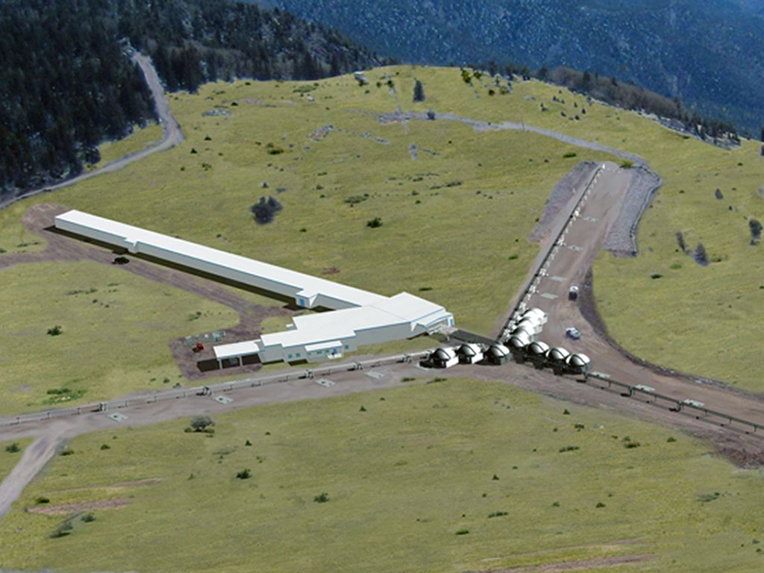
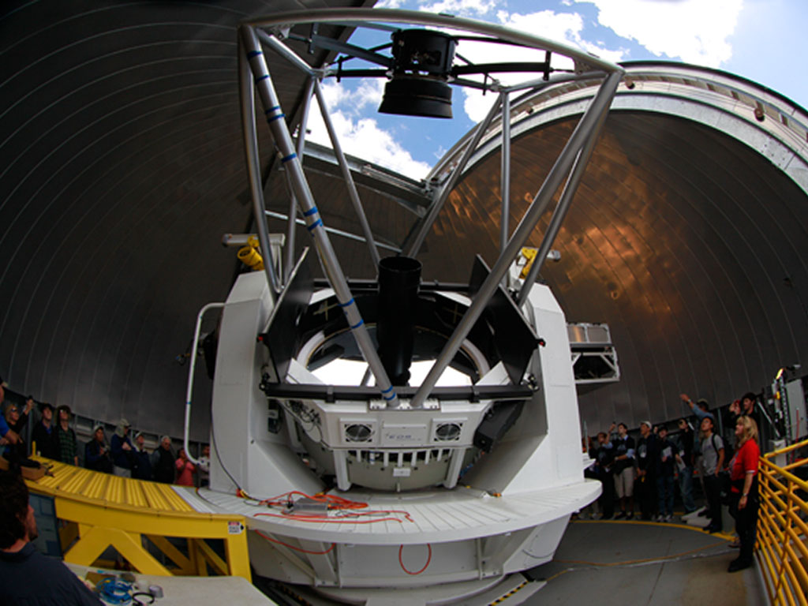
Scenario 2: Real-time imaging in complex services
Vision Pro
Spatial calculations
Optical interferometer telescope^{[1]}
Function: Real-time computational spatial imaging Real-time: Real-time rendering, imaging acquisition Versatility: User-defined tasks at the upper level
Function: Multiple telescopes track interferometric imaging of stars in real time Real-time: Real-time imaging and tracking system for interstellar objects Versatility: control system, network transmission
More application scenarios: vehicle camera, drone data transmission......
[1] Seneta, Eugene B., et al. "When you want it done right now: experience from programming hard real time systems in Xenomai for the Magdalena Ridge Observatory interferometer." Software and Cyberinfrastructure for Astronomy VI. Vol. 11452. SPIE, 2020.

Slide 5
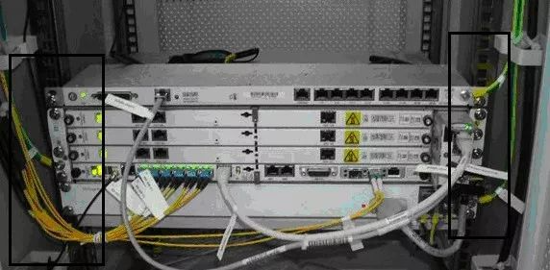
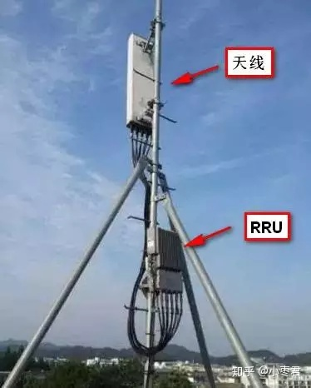

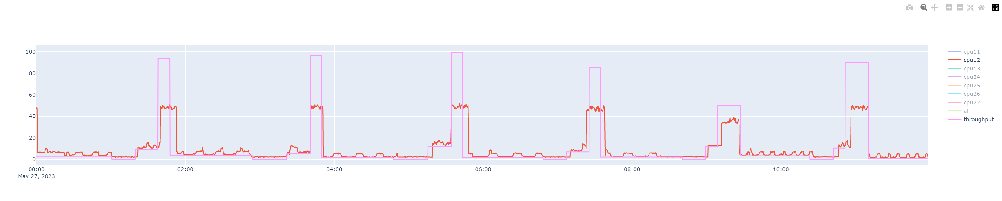
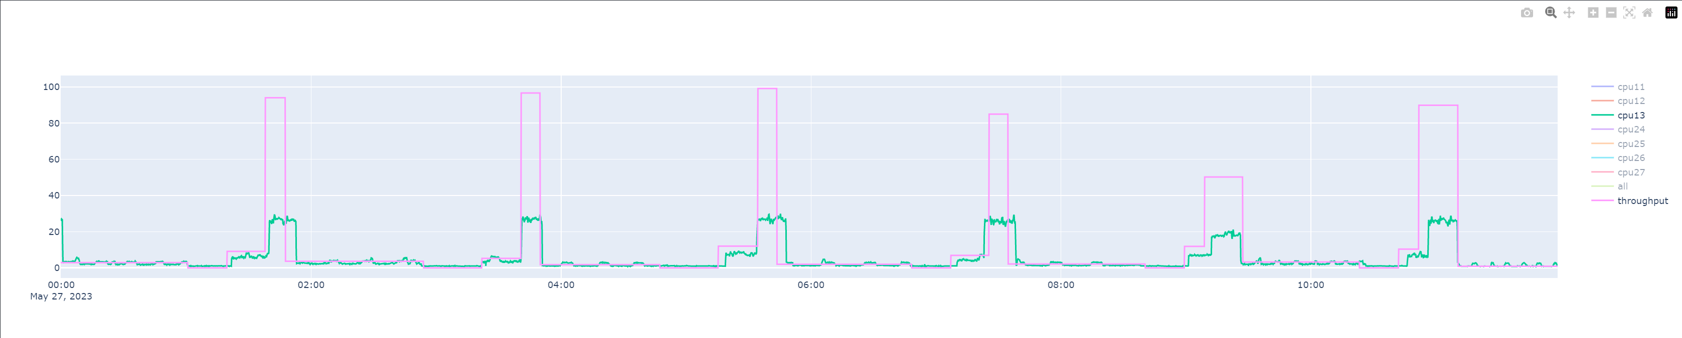
Scenario 3: 5G base stations share computing resources
Symptom 1: 5G BBUs are idle after white-boxing
Symptom 2: The base station is rich in resources and the load timing is jitter
aerial
BBU
RRU
BBU（Base band Unite）
Function: Add packet protocol header; Attributes: real-time tasks, requiring hard real-time; Hardware: white-box BBU (50% idle resources);
User-specific task loads
Function: User Defined; Attributes: General tasks, no real-time requirements; Hardware: COTS architecture can be satisfied；
The BBU white-box unit processes both real-time and general-purpose tasks to improve resource utilization[1]
[1] Foukas, Xenofon, and Bozidar Radunovic. "Concordia: Teaching the 5G vRAN to share compute." Proceedings of the 2021 ACM SIGCOMM 2021 Conference. 2021.

Slide 6
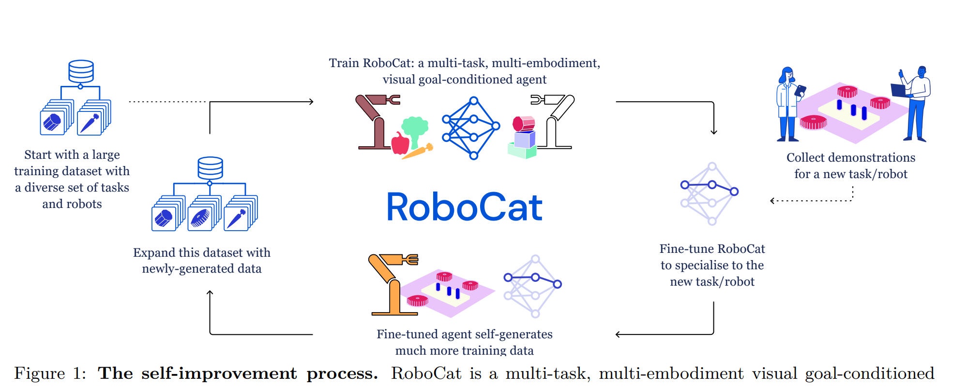

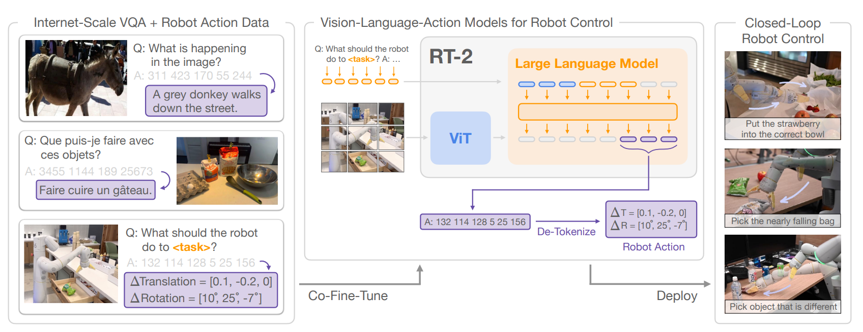
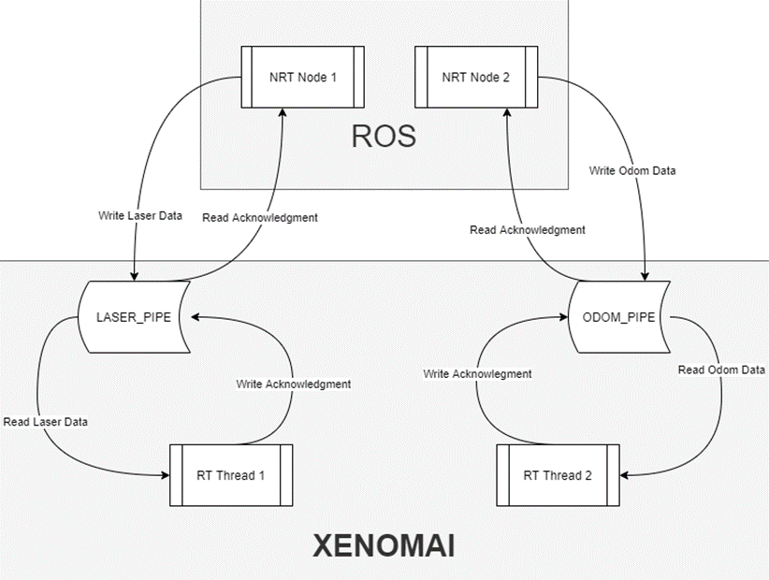
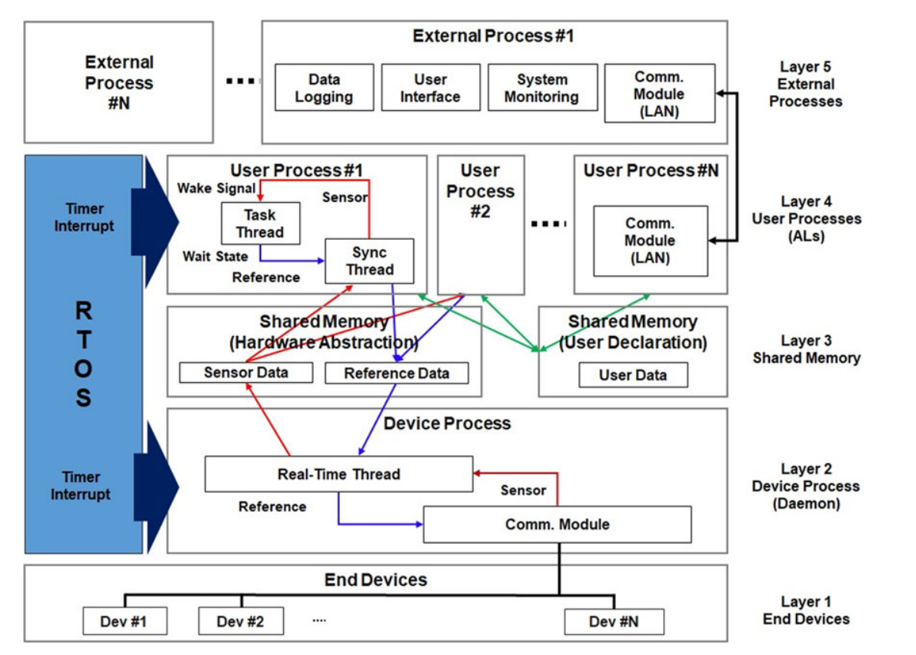
Scenario 4: Embodied intelligent robots
Embodied intelligent robots
RoboCat System: ROS System
Optimus Gen2 System: ROS System
RT-2 system: ROS system
Real-time: robot control
Generality: AI large model tasks
There are already dual-kernel architecture robots.
The ROS system enhances real-time performance with Xenomai
Real-time enhanced robot DRC-HUBO+ architecture
(published in TRO)

Slide 7
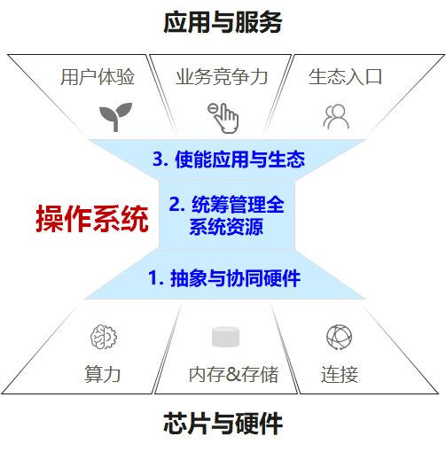
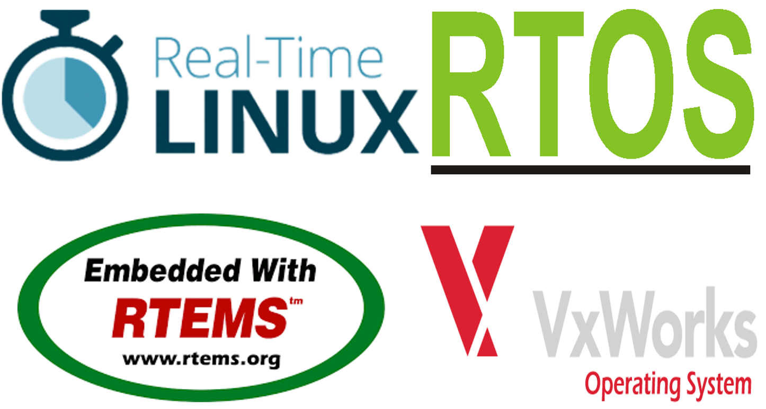
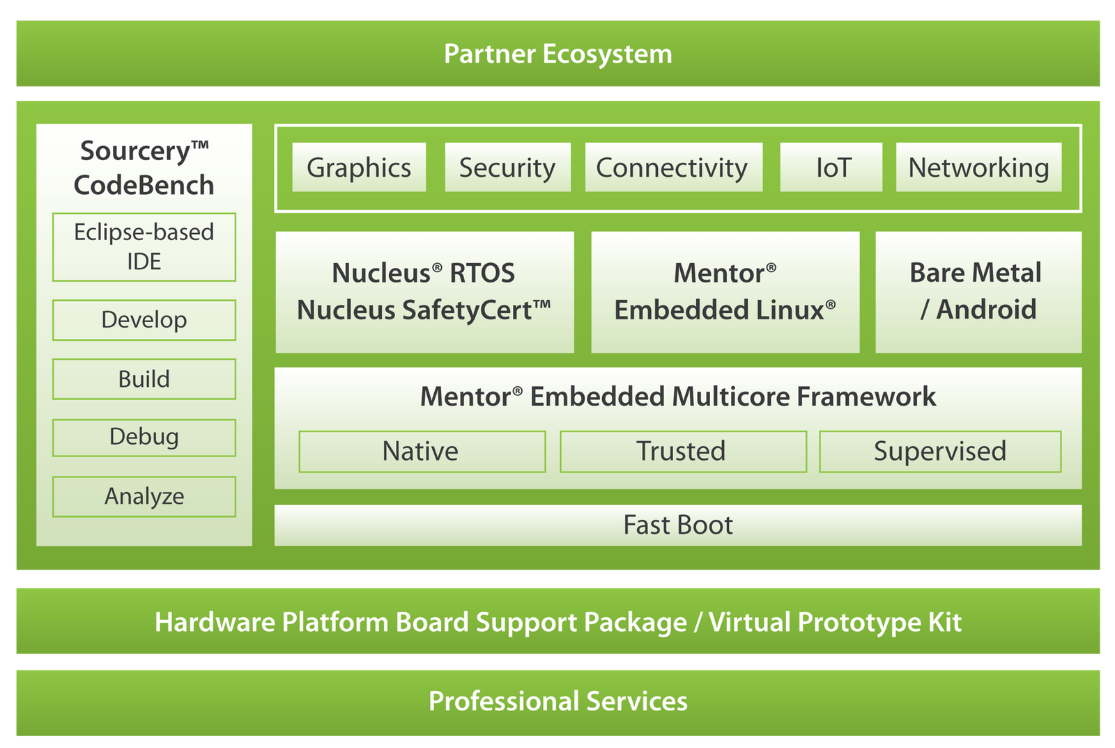
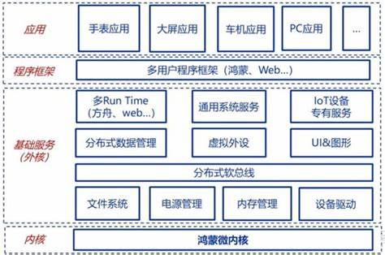
Real-time and generality challenges
复杂终端任务需要
“新操作系统”的支持
操作系统是控制和管理计算机硬件的最基本、最核心的系统软件，起到承上启下的关键作用：“向下”调度资源，“向上”统一接口、提供服务
现有两大类操作系统的不足
通用操作系统：
实时性差
系统繁重
可靠性低
实时操作系统：
通用性差、高度定制化
非开源、安全性差
价格昂贵

Slide 8
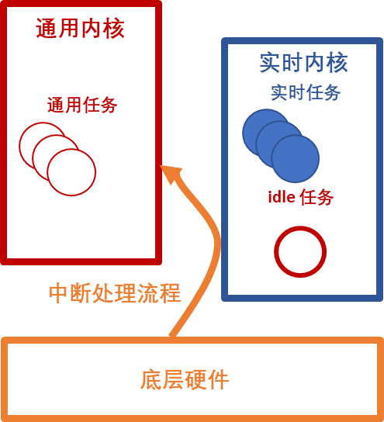
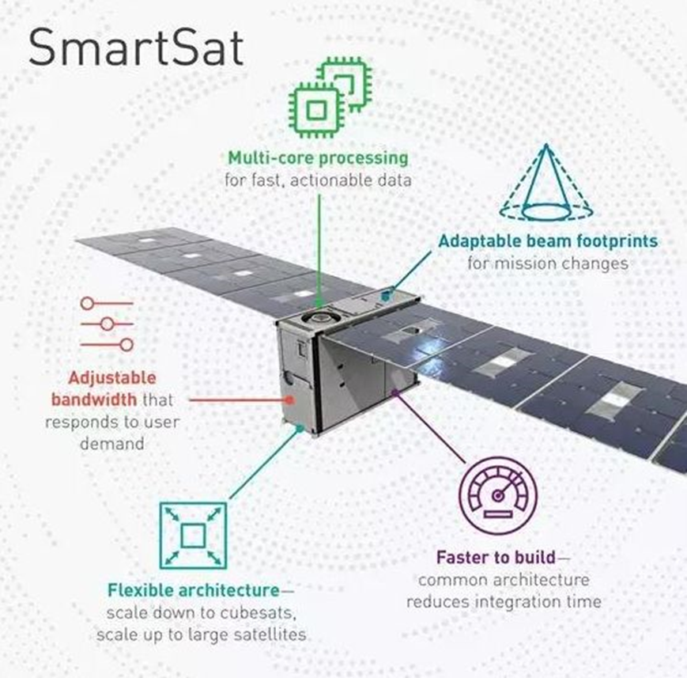
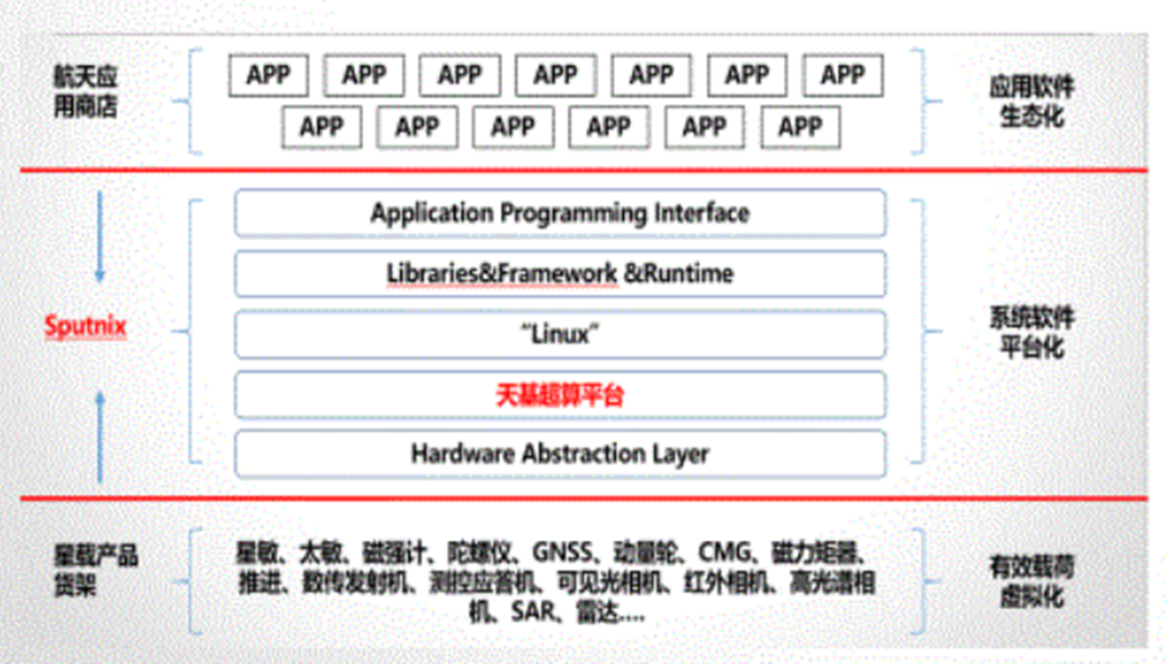

实时性和通用性兼容难题
现有解决思路
双内核
整体架构
Linux内核提供通用性支持
实时内核提供硬实时保证
中断虚拟化隔离内核，减少开销
中断处理流程
底层硬件产生的中断首先发送到实时内核
若实时内核无对应中断处理函数再向通用内核转发
任务处理流程
优先处理实时任务，所有的实时任务都处理完，处理idle任务，即通用内核的任务
SpaceX猎鹰火箭，星链卫星，dragon飞船均采用COTS器件作为计算硬件，利用三模冗余提升可靠性，采用Preempt-Linux作为主要的操作系统^{[1]}
天智卫星^{[2]}采用Linux作为主要的操作系统
缺点：实时性差
Smartsat^{[3]}星座采用Hypervisor技术同时运行Linux和实时操作系统
缺点：内核隔离较重，性能受限，资源静态分配
[1] ELC: SpaceX lessons learned https://lwn.net/Articles/540368/
[2] https://news.lockheedmartin.com/2019-03-20-Lockheed-Martins-First-Smart-Satellites-are-Tiny-with-Big-Missions
[3] https://max.book118.com/html/2020/1220/7152012022003033.shtm

Slide 9




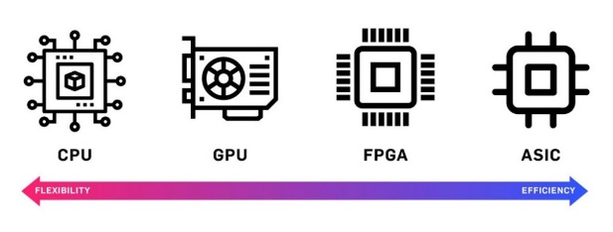



Real-time and generality challenges
High dynamics,
better real-time
 | Dual-kernels | Hypervisors | Preempt-rt
Resource allocation | Dynamic | Static | Dynamic
Real-time | Hard real-time | Hard real-time | Soft real-time
Ease of development | Easy | Hard | Easy
Isolation | Moderate isolation | Complete isolation | No isolation
Difficulty of maintenance | medium | high | low
Real-time
Generality
Dual-kernels
Hypervisors
Preempt-rt

Slide 10
Real-time and generality challenges
High dynamics,
better real-time
 | Dual-kernels | Hypervisors | Preempt-rt
Resource allocation | Dynamic | Static | Dynamic
Real-time | Hard real-time | Hard real-time | Soft real-time
Ease of development | Easy | Hard | Easy
Isolation | Moderate isolation | Complete isolation | No isolation
Difficulty of maintenance | medium | high | low
Real-time
Generality
Dual-kernels
Hypervisors
Dual-kernel system application range
The execution environment is trusted The demand for real-time performance is moderate General load dynamics
Scope of application of virtual machine systems
The execution environment cannot be trusted The real-time demand is high, and the consequences of failure are significant The real-time load is small, and the task resources are abundant

Slide 11
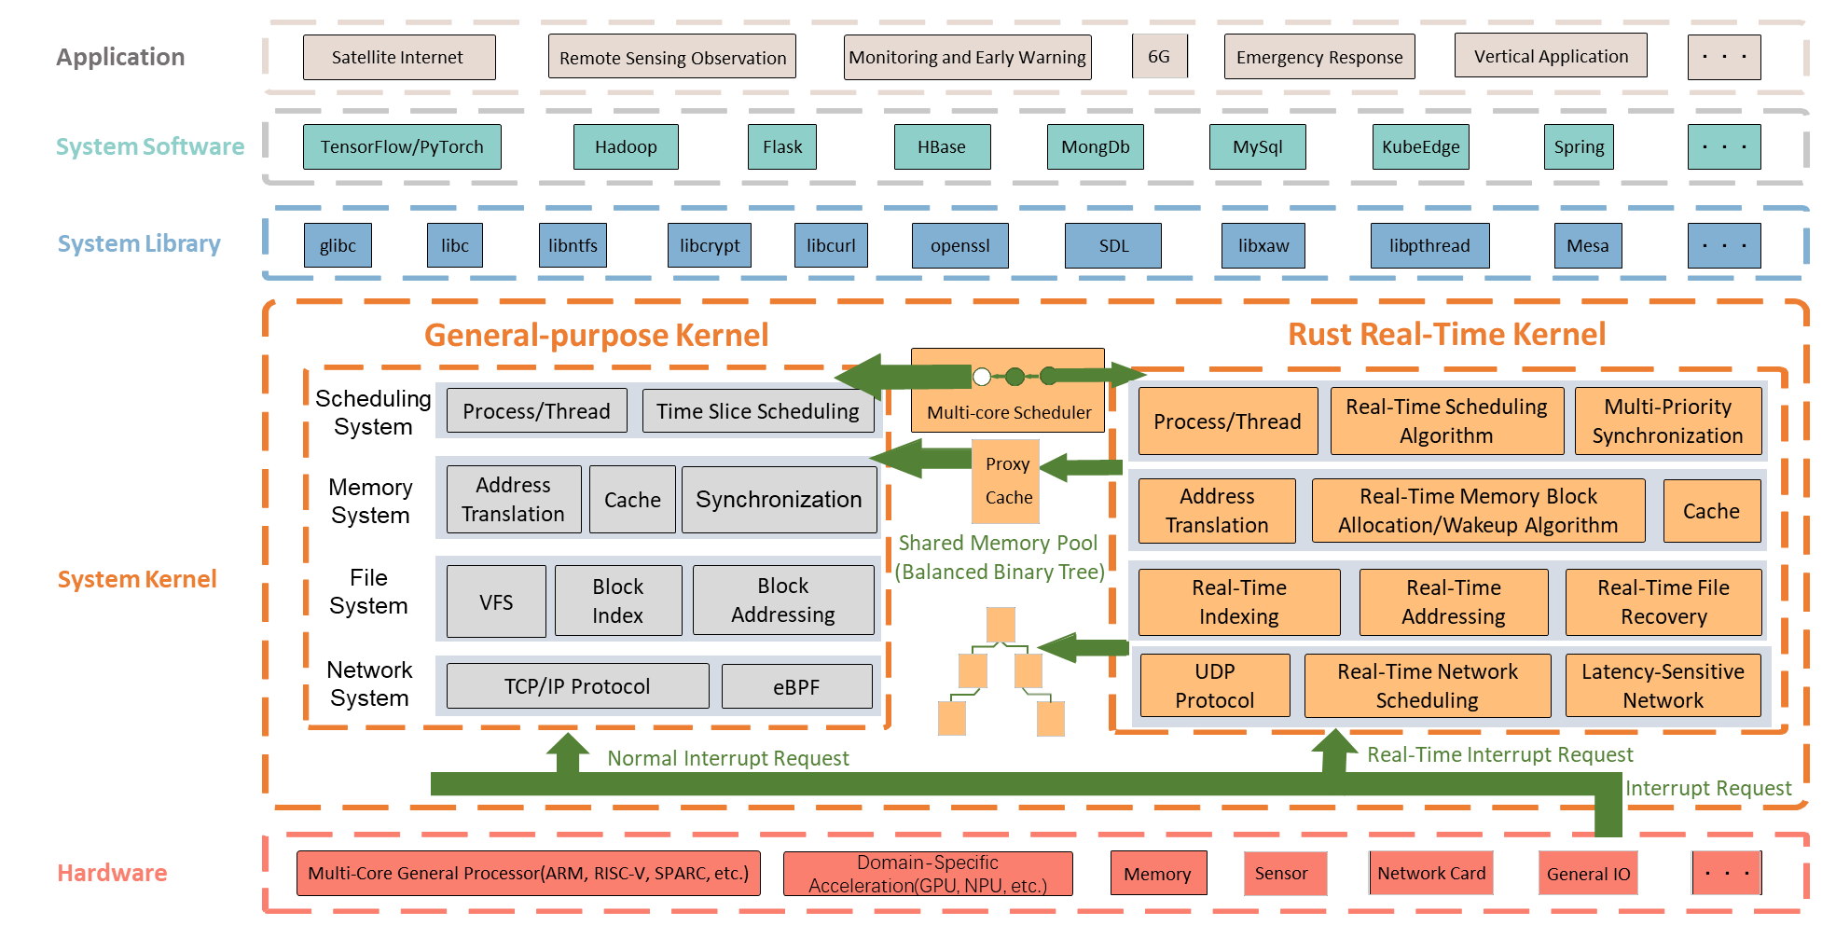
RROS architecture
General-purpose kernel Linux (C-based) + Real-time kernel (Rust-based)
Rust language advantages
Memory safety Performance Concurrent programming Active community
RROS Advantage
Strong real-time: Hard real-time, compatible with existing RTOS interfaces, making application migration, maintenance, and development simpler Good versatility: With the help of Linux's rich ecosystem, complex applications such as TensorFlow/k8s can be directly deployed High stability: Developed based on Rust, the stability of the real-time kernel has been enhanced Simple interaction: The interaction between the real-time kernel and the Linux kernel is simple and the isolation is small Good adaptability: Linux is used to complete the startup, which is easier to adapt to the new architecture/new version

Slide 12
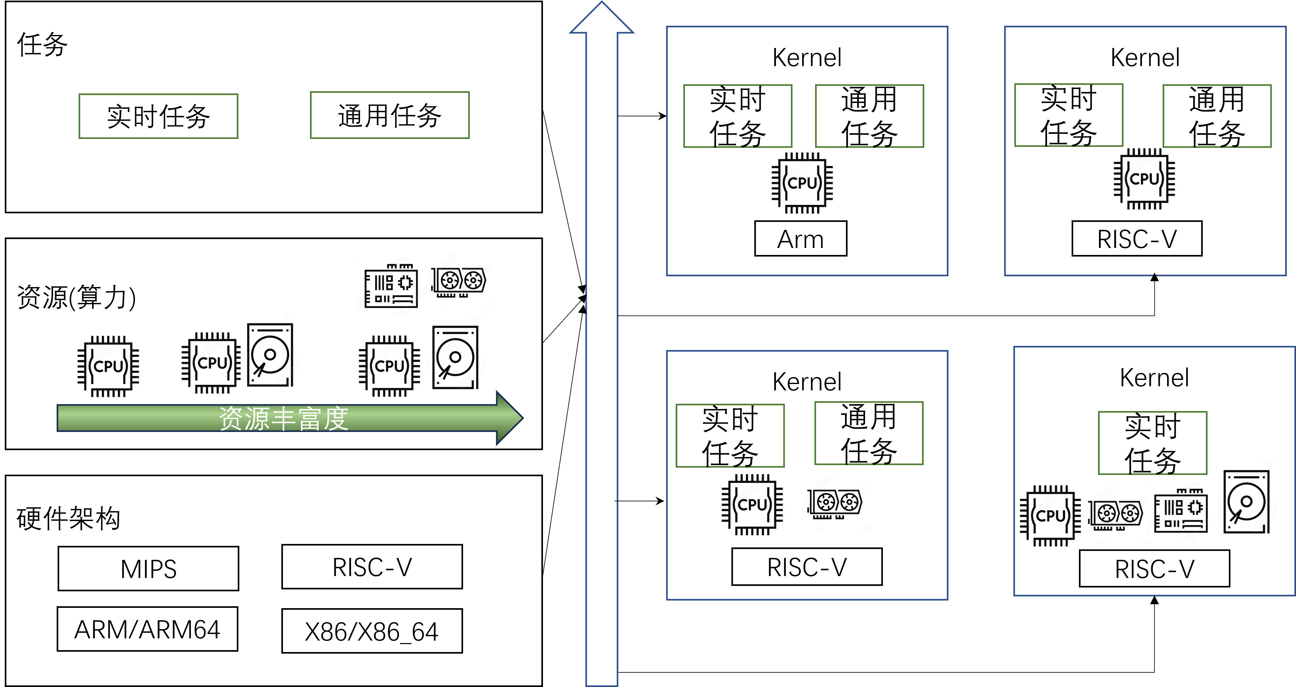
RROS architecture
Flexible management and scheduling of RROS kernels
Flexibly adjust the size of the Linux kernel according to the resource differences of different hardware
For resource-rich scenarios, such as handheld terminals and on-board chips, general-purpose Linux is used For general resource scenarios, such as base station gateways, monitoring probes: use clipped Linux For resource-scarce scenarios, such as ocean buoys and meteorological monitoring sites, ucLinux is used
In view of the imperfect ecology of the real-time operating system, multiple real-time interfaces are provided
RROS architecture | Resource requirements | Kernel size | Target hardware | Real-time interfaces
Linux+R kernel | high | 15~30MB | Zynq, NVIDIA Jetson, etc | Evl,FreeRTOS,µc/os,Vxworks
Simpled Linux + R kernel | middle | 3~7MB | RPi, HiFive Unmatched, etc | Evl,FreeRTOS, µc/os,Vxworks
ucLinux+R kernel | low | 400~700KB | STM32, RT1052, etc | Evl,FreeRTOS, µc/os,Vxworks

Slide 13
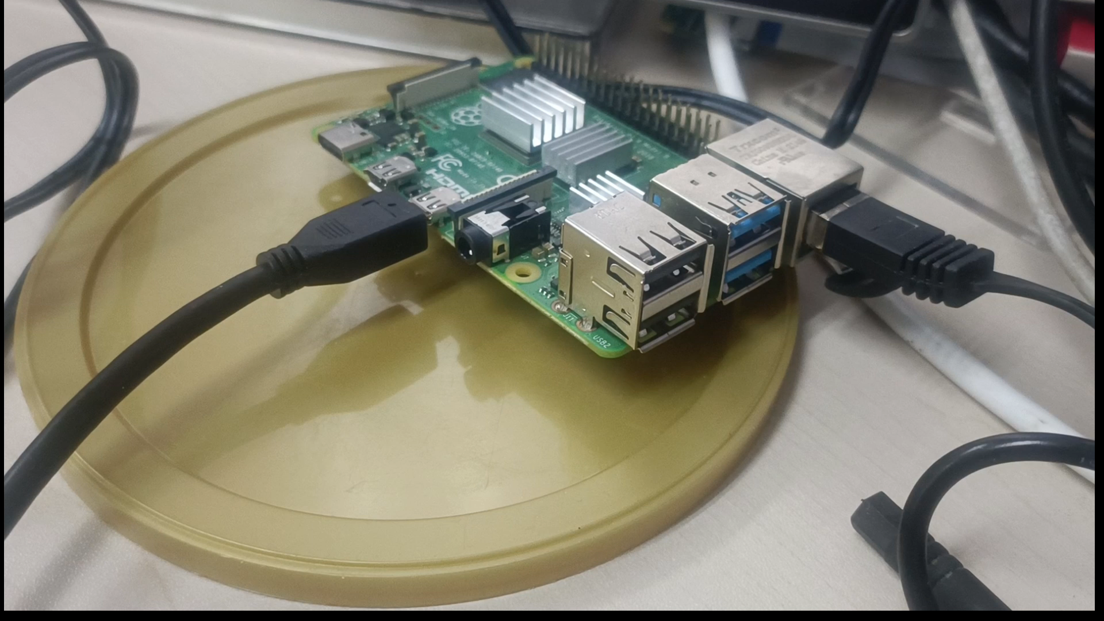
RROS Basic Capabilities
Real-time operating system subsystem
Thread
It supports multiple real-time scheduling algorithms such as FIFO/RR/TP Priority inheritance, the ceiling algorithm solves the priority inversion problem
Memory
Real-time dynamic memory allocation algorithm ensures system flexibility and real-time
File
Real-time file system improves the real-time data access
Network
The UDP protocol stack is used to process UDP packets in real time
Driver
External devices are driven in real time through interfaces such as GPIOs to ensure real-time performance
Ecological aspects
Linux applications can be migrated and run natively Compatible with x86/x86_64/arm/arm64 architectures Compatible with Raspberry Pi development boards The kernel can be adapted to a wide range, supporting kernel trimming to 150kb, which can run on MCUs with 2MB storage and 256KB memory
For real-time applications, real-time interfaces such as FreeRTOS, μc/os, Vxworks, etc. are provided Compatible with RISC-V architecture, Rockchip development board

Slide 14
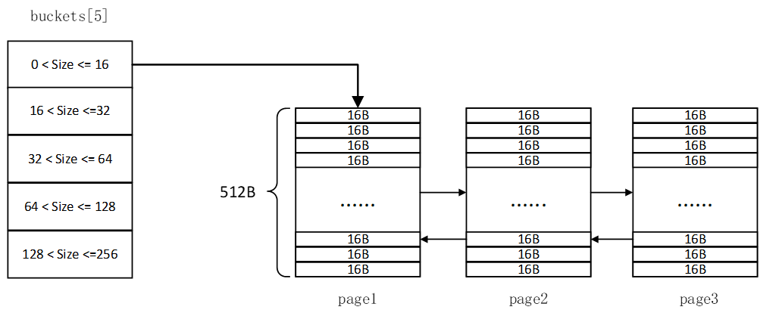
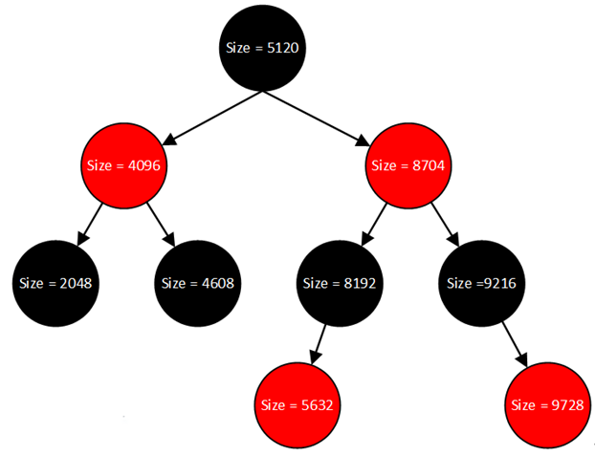
RROS real-time memory management
Memory issues | Solution
Memory allocation time is highly complex | Efficient allocation algorithm + reserved space/delayed release
Lacking of isolation | Dual memory pools isolate real-time and general-purpose applications
Hard/Soft Page Fault | Kernel vmalloc allocation
TLB/Cache miss | Real-time kernel cache dynamic keep-alive
Fast buffer pool is used for small memory management, and the time complexity is O(1)
Large memory management to find from red and black trees Time complexity is O(logn)

Slide 15
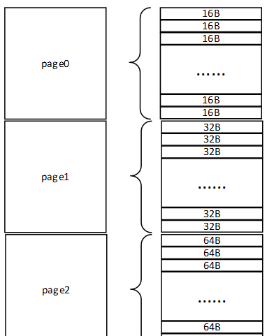
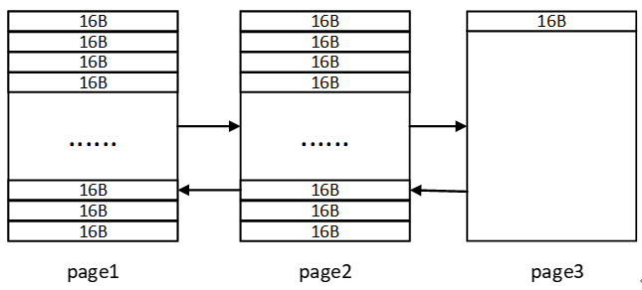
RROS real-time memory management
Memory issues | Solution
Memory allocation time is highly complex | Efficient allocation algorithm + reserved space/delayed release
Lacking of isolation | Dual memory pools isolate real-time and general-purpose applications
Hard/Soft Page Fault | Kernel vmalloc allocation
TLB/Cache miss | Real-time kernel cache dynamic keep-alive
The delayed release method is used to improve real-time performance when managing the release of small memory
The reserved space method is used to improve real-time performance when managing the allocation of large memory

Slide 16
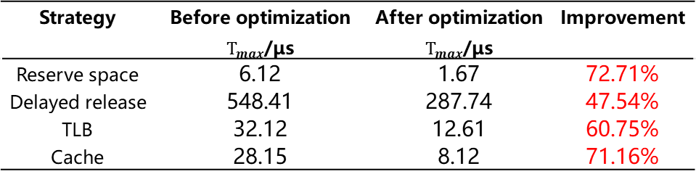
RROS real-time memory management
Memory issues | Solution
Memory allocation time is highly complex | Efficient allocation algorithm + reserved space/delayed release
Lacking of isolation | Dual memory pools isolate real-time and general-purpose applications
Hard/Soft Page Fault | Kernel vmalloc allocation
TLB/Cache miss | Real-time kernel cache dynamic keep-alive
Keep-alive Workflow
Keep the real-time kernel cache alive while the generic kernel is executing Refresh all caches for TLBs and some caches for caches Periodic access to page table entries boosts the count A read-ahead instruction __builtin_prefetch is inserted during compilation, and the data resides in the cache
Strategy | Before optimization $T_{max}$/μs | After optimization $T_{max}$/μs | Improvement
Reserve space | 6.12 | 1.67 | 72.71%
Delayed release | 548.41 | 287.74 | 47.54%
TLB | 32.12 | 12.61 | 60.75%
Cache | 28.15 | 8.12 | 71.16%

Slide 17
RROS Security Guarantee
Realtime application && General application
RROS
kernel
Linux kernel
Sched
Subsystem
Sched
Subsystem
Thread API
Clock
Subsystem
Clock
Subsystem
GPU Subsystem
Gpio
Subsystem
Clock API
BUG
Mem
Allocator
Mem API
Mem
Allocator
Monitor
Subsystem
FPGA
Subsystem
File
subsystem
File
subsystem
VFS API

Slide 18
RROS Security Guarantee
Realtime application && General application
RROS
kernel
Linux kernel
Sched
Subsystem
Sched
Subsystem
Thread API
Clock
Subsystem
Clock
Subsystem
GPU Subsystem
Gpio
Subsystem
Clock API
BUG
BUG
Mem
Allocator
Mem API
Mem
Allocator
Monitor
Subsystem
FPGA
Subsystem
File
subsystem
File
subsystem
VFS API

Slide 19
RROS Security Guarantee
Realtime application && General application
RROS
kernel
Linux
kernel
Sched
Subsystem
Sched
Subsystem
Thread API
Thread API
Gpio
Subsystem
Clock
Subsystem
Clock
Subsystem
GPU Subsystem
Clock API
Clock API
Mem
Allocator
Mem
Allocator
BUG
FPGA
Subsystem
Monitor
Subsystem
Mem API
Mem API
File
subsystem
File
subsystem
VFS API
VFS API

Slide 20
RROS Security Guarantee
Realtime application && General application
RROS
kernel
Linux
kernel
Sched
Subsystem
Sched
Subsystem
Thread API
Thread API
Gpio
Subsystem
Clock
Subsystem
Clock
Subsystem
GPU Subsystem
Clock API
Clock API
Mem
Allocator
Mem
Allocator
BUG
FPGA
Subsystem
Monitor
Subsystem
Mem API
Mem API
File
subsystem
File
subsystem
VFS API
VFS API

Slide 21
RROS Security Guarantee
Realtime application
RROS
kernel
Sched
Subsystem
Thread API
Gpio
Subsystem
Clock
Subsystem
Clock API
Mem
Allocator
Monitor
Subsystem
Mem API
File
subsystem
VFS API

Slide 22
RROS Security Guarantee
Realtime application && General application
RROS
kernel
Linux
kernel
Sched
Subsystem
Sched
Subsystem
Thread API
Thread API
Gpio
Subsystem
Clock
Subsystem
Clock
Subsystem
GPU Subsystem
Clock API
Clock API
Mem
Allocator
Mem
Allocator
FPGA
Subsystem
Monitor
Subsystem
Mem API
Mem API
File
subsystem
File
subsystem
VFS API
VFS API

Slide 23
RROS Security Guarantee
Realtime application && General application
RROS
kernel
Linux
kernel
Sched
Subsystem
Sched
Subsystem
Thread API
Thread API
Gpio
Subsystem
Clock
Subsystem
Clock
Subsystem
GPU Subsystem
Clock API
Clock API
Mem
Allocator
Mem
Allocator
Monitor
Subsystem
Mem API
Mem API
FPGA
Subsystem
File
subsystem
File
subsystem
VFS API
VFS API

Slide 24
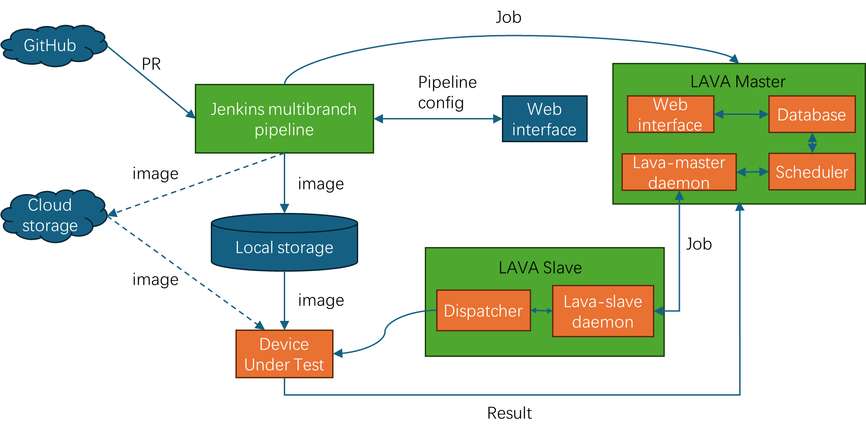
RROS CI system
Get the latest code in the repository and automatically build the kernel
Run QEMU or physical tests based on the configuration
Build a unified real-time performance test load to automatically test and compare the performance of other real-time operating systems
During the test, QEMU was used to simulate the particle inversion of an outer space device under the influence of rays

Slide 25
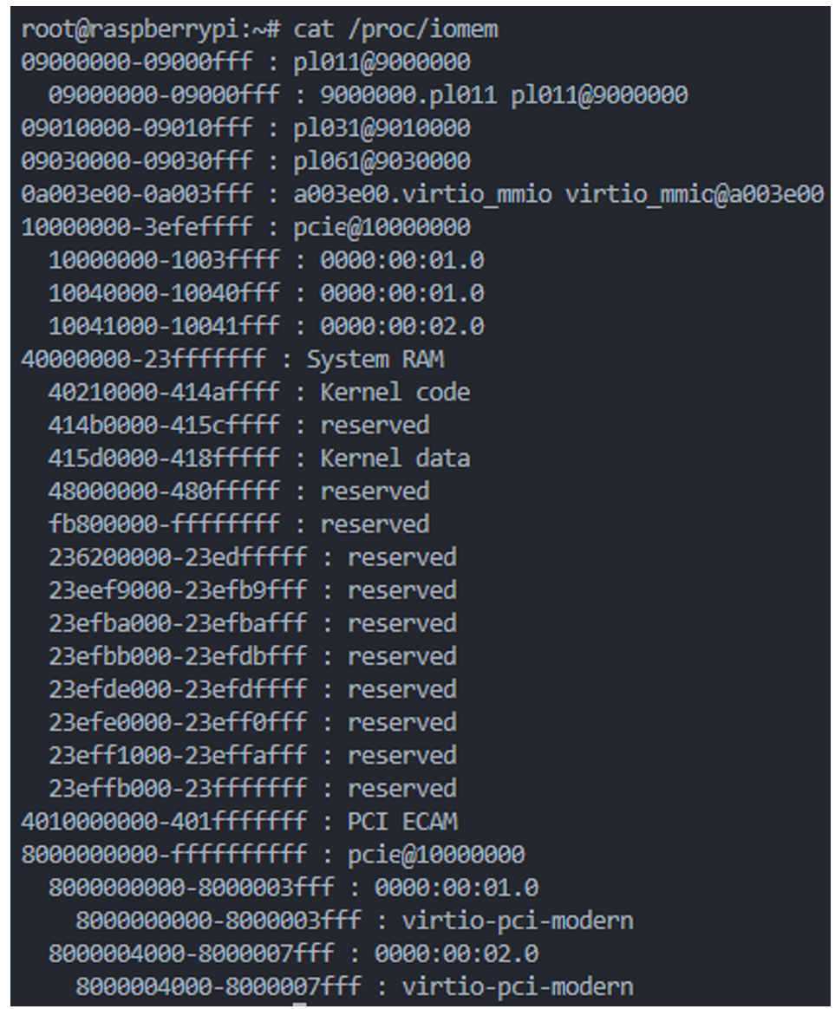
SEU simulation in qemu
Qemu
Physical memory detection
RAM: Kernel memory
Device memory
Cpu register

Slide 26
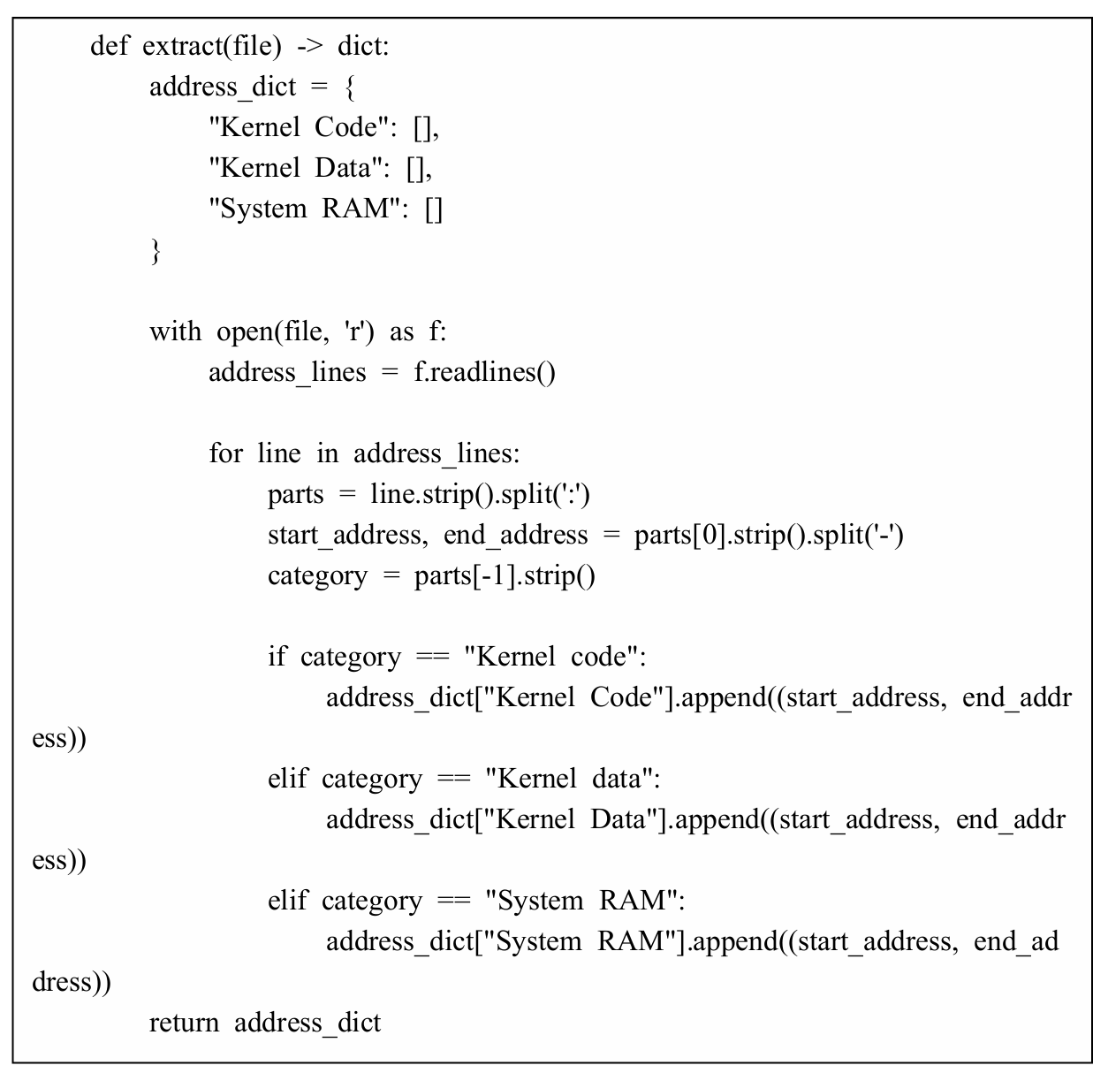
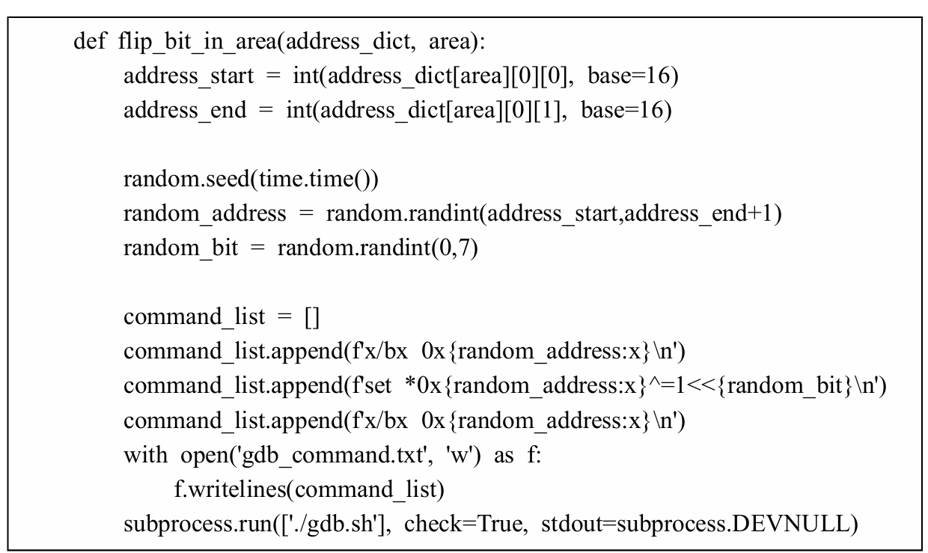
SEU simulation in qemu
Qemu
Physical memory detection
Bit flip in Kernel(Code/Data), Userspace
Random flip

Slide 27
Comparison of RROS with existing operating systems
Attributes | RROS | Xenomai | Real-Time Linux | Vxworks | uc/os-III | QNX | Free RTOS | Nuttx | Harmony
Real-time | ♥♥♥ | ♥♥♥ | ♥ | ♥♥♥ | ♥♥♥ | ♥♥♥ | ♥♥♥ | ♥♥♥ | ♥
Ecosystem | ♥ | ♥♥ | ♥♥♥ | ♥♥ | ♥♥ | ♥♥ | ♥♥ | ♥♥♥ | ♥♥♥
Stability | ♥♥♥ | ♥♥♥ | ♥ | ♥♥♥ | ♥♥♥ | ♥♥♥ | ♥♥♥ | ♥♥♥ | ♥♥♥
Isolation | ♥♥ | ♥♥ | ♥ | No | No | ♥♥♥ | No | No | No
performance | ♥♥ | ♥♥♥ | ♥♥♥ | ♥ | ♥ | ♥ | ♥♥♥ | ♥ | ♥
Adaptability | ♥ | ♥ | ♥♥ | ♥ | ♥ | ♥ | ♥ | ♥♥♥ | ♥♥♥
user mode Real-time | √ | √ | √ | √ | × | √ | √ | √ | √
Kernel mode real-time | √ | √ | × | √ | √ | √ | √ | √ | √
Open source | √ | √ | √ | × | × | × | √ | √ | √

Slide 28
RROS development timeline
2021.11 Project launched 2022.11 Completed the process management and scheduling subsystem, implemented HelloWorld on QEMU, and completed the V0.1 version of the kernel 2023.4 Completed the adaptation of the development board and successfully ran it on the Raspberry Pi
2023.6 Complete the memory, file, and network subsystems of the real-time kernel, and implement system calls, which can call real-time threads in user mode 2023.11 RROS open source 2023.12.9 RROS was launched with a satellite, becoming the first Rust OS to operate in orbit

Slide 29
RROS development plan
Security enhancements
Formal verification
Fault tolerant
Function
POSIX interface
architecture：RISC-V/ loongarch
Ground scene
ROS2
5GRAN
ethercat
Real-time data transmission/spatial computing
Space scenes
On-board computer
Rustify satellite Software
Releases
working at Linux 6.6

Slide 30
Practice: Porting Dovetail onto RISC-V
Backgroud / Motivation
What is Dovetail
How to port Dovetail onto RISC-V

Slide 31
Background / Motivation
Dovetail only support x86/64, arm, arm64 architecture
Dovetail is easier to port than I-pipe
RISC-V is open-sourced ISA
=> Why not to have a try to support RISC-V for Dovetail

Slide 32
What is Dovetail
Dovetail introduces
A kernel interface which introduces a high-priority execution stage into the main kernel logic.[1]
Ability to preempt the common work for out-of-band activities at any time
Bounded response time to external interrupts and ultra-low latency scheduling capabilities for a real-time core, which connect to Dovetail interface
[1] https://v4.xenomai.org/dovetail/

Slide 33
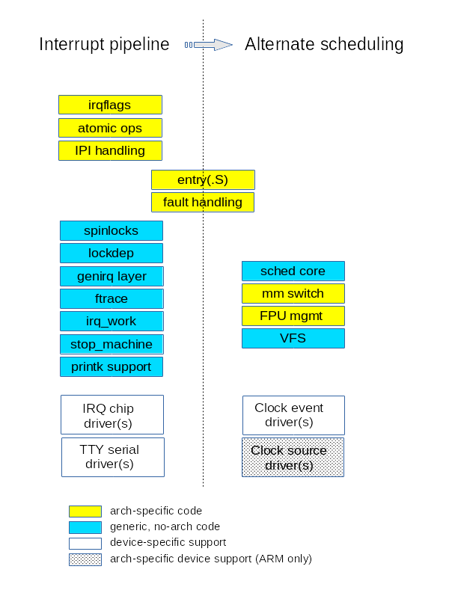
How to port Dovetail onto RISC-V
Which parts do we need to port
Top interrupt handler
Virtual irqflags
Atomic operations
IPI handling
Fault handling
mm switch
FPU mgnt

Slide 34
How to port Dovetail onto RISC-V
Top interrupt handler
RISC-V stvec register mode
Direct mode: stvec 保存一个固定的入口地址，所有中断和异常都会跳转到这个地址 + kernel code 使用 scause register 判断exception类型
Vector mode: stvec 保存一个基地址，不同的中断类型（由 scause register指出）会跳转到基地址加上偏移量的地址

Slide 35
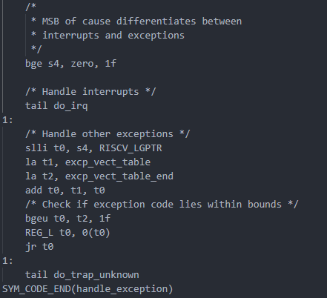
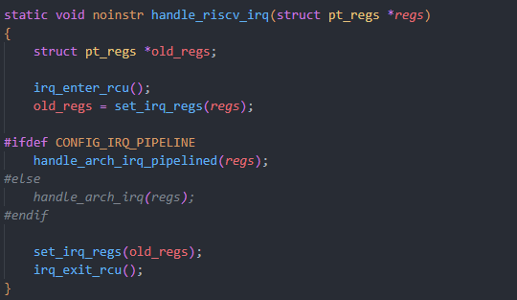
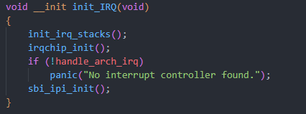
How to port Dovetail onto RISC-V
Top interrupt handler
entry.S中根据scause的高位确定是中断还是异常, 从而 进入不同的处理路径
handle_exception -> do_irq ->handle_riscv_irq
handle_arch_irq: start_kernel() -> init_IRQ()-> irqchip_init() -> 设置handle_arch_irq

Slide 36
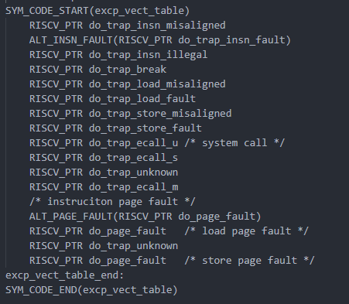
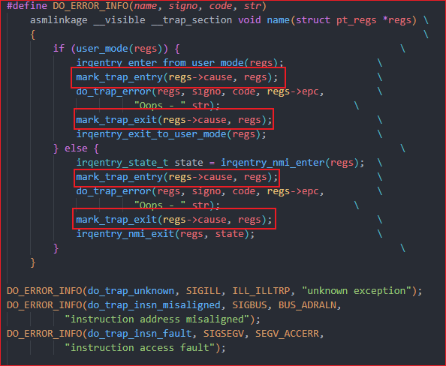
How to port Dovetail onto RISC-V
Fault handling
对于exception, 通过mark_trap_entry与mark_trap_exit 将exception传递给real-time core进行处理

Slide 37
How to port Dovetail onto RISC-V
IPI handling
What is IPI => Inter-Processor Interrupt
用于：
调度核间任务
多核同步操作，e.g. 刷新共享缓存, 刷新TLB等
核间通知, e.g. 系统关闭或重启时

Slide 38
How to port Dovetail onto RISC-V
IPI handling
CLINT: RISC-V本地中断控制器, 负责管理软件中断和定时器中断
IPI属于软件中断的一种
Linux将msip寄存器映射为核间中断寄存器
src processor -> dst processor 写入msip触发IPI
arch/riscv/kernel/smp.c中send_ipi_mask函数用于主动调用核间中断
IPI的中断处理, 和普通interrupt是没有区分的

Slide 39
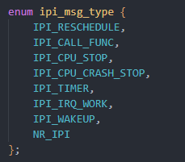
How to port Dovetail onto RISC-V
IPI handling
由于Dovetail是为real-time core提供kernel interface, 所以real-time core也需要处理自己的IPI信号
ARM64: SGI从0-7用于处理不同的IPI
ARM64 SGI编号从0-15, 所以需要对SGI进行复用 以保证未来IPI扩展的需求和real-time core对多种IPI的需求
定义PERCPU变量 ipi_message,
在send ipi时, 同步修改目标cpumask的ipi_message
在handle ipi时, SGI0对应irq handler不再是IPI_RESCHEDULE 而是作为linux kernel的ipi通知, 真正的ipi type通过ipi_message读取

Slide 40
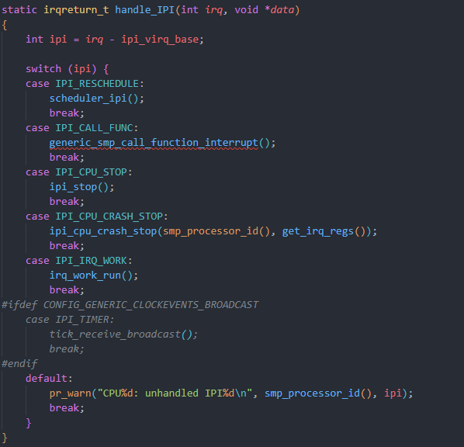
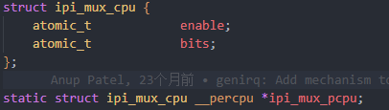
How to port Dovetail onto RISC-V
IPI handling
由于Dovetail是为real-time core提供kernel interface, real-time core也需要处理自己的IPI信号
RISC-V:
RISC-V只有msip register用于触发IPI中断
RISC-V使用linux kernel提供的ipi-mux机制, native的复用了单独的ipi
使用ipi_mux_pcpu数组在核间同步ipi message type

Slide 41
How to port Dovetail onto RISC-V
Virtual irqflags
We have pipelined interrupt & exception handler now
But for the irqflags operation in common tasks
Disable the interrupt
Uncontrollable critical section
Real-time task can not response in a bounded time

Slide 42
How to port Dovetail onto RISC-V
Virtual irqflags
All the common task use unified interface as
local_irq_enable (generic code) -> arch_local_irq_ebable (arch specific code)
local_irq_disable (generic code) -> arch_local_irq_disable (arch specific code)
local_irq_save(generic code) -> arch_local_irq_save (arch specific code)
local_irq_restore (generic code) -> arch_local_irq_restore (arch specific code)
xxx
Redefine arch_xxx and define hard_local_irq_xxx
Use a reserved bit to store virtual irqflags
Add native_save_flags, native_irq_enable, native_irq_disable, xxx as truly access of CSR register

Slide 43
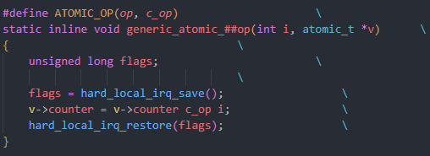
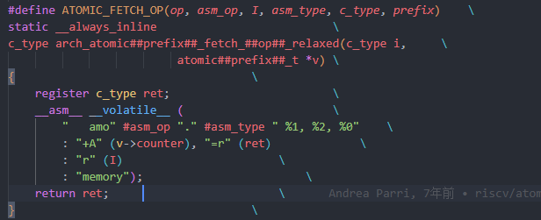
How to port Dovetail onto RISC-V
Atomic operations
Some architectures(e.g. arm) use interrupt to implement the atomic operations
Used arch_local_irq_ebable in the macro
Replace arch_local_irq_xxx functions to hard_local_irq_xxx to make atomic operations correctly
由于RISC-V架构相关的atomic operations都是汇编写的, 而不是使用中断实现的 => atomic operations不用做porting

Slide 44
Build open source together
Thanks
Q&A
2024/11/23
44

